Slide 1


Water Conservation
Created by The WaterShed

Slide 2

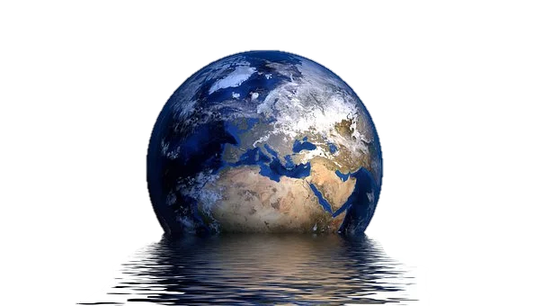
Today
We Will…
Estimate Global Water Availability
Observe Global Water Distribution
Discover your Water Footprint
Discuss Personal & Community Solutions for Water Conservation
Notes:
Today we are going to learn about how to save water or water conservation. We’ll do an activity to estimate global water availability, observe global water distribution in a video, discover your water footprint with an art activity and discuss personal and community solutions.

Slide 3

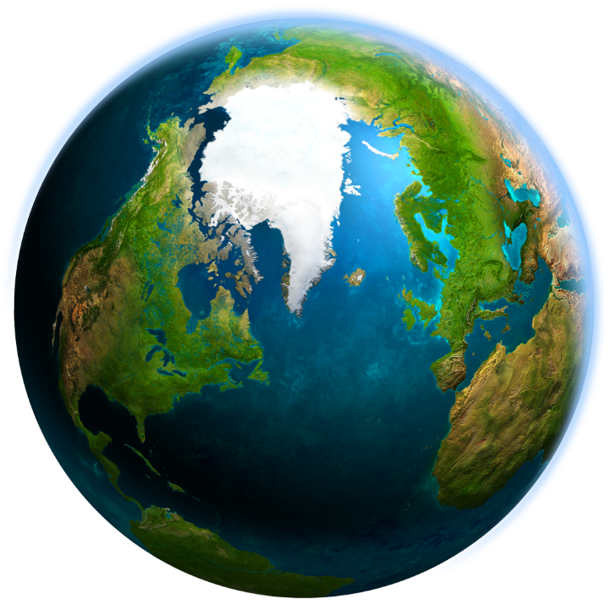

Where do we find water on Earth?
Notes:
Where do we find water on Earth?
We live on the Blue Planet – it’s 75% covered by water. Show inflatable globe. It seems as if we have a lot of water to go around!

Slide 4
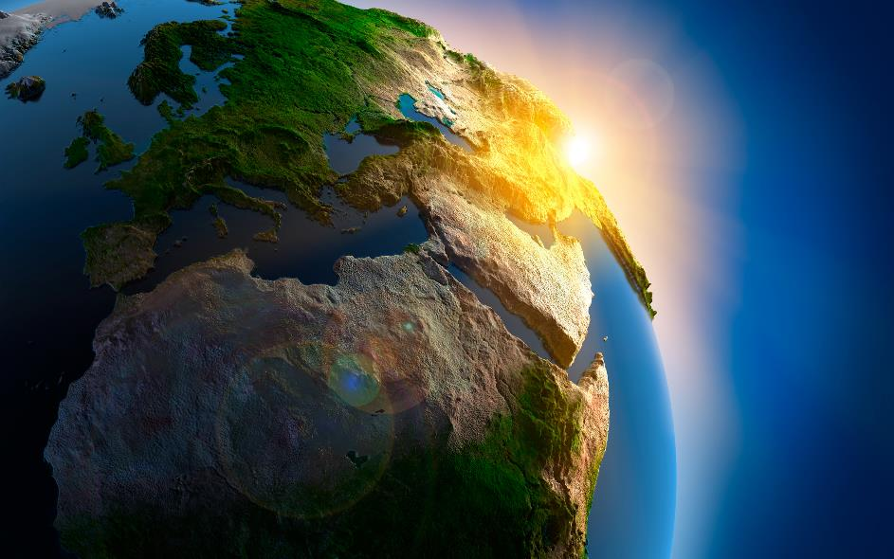

How much of all the water on Earth is available for our daily needs ?
What % is Salt Water?
What % is Fresh Water?
Notes:
There is a lot of water on our planet, but how much is freshwater. There is a good amount of saltwater, but we can’t use salt water – well we could, but we’d have to remove the salt first and that’s very expensive. We depend on fresh water to do all our daily activities like drink, use the bathroom, clean, grow food, and manufacture items. Turn to someone next to you and come up with an estimate of how much of our water is fresh and how much is salt.
What did you come up with? Now we are going to do an experiment to see exactly how much water is available for us to use on the planet.

Slide 5
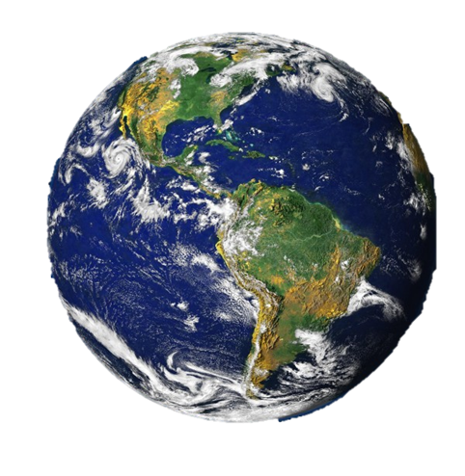
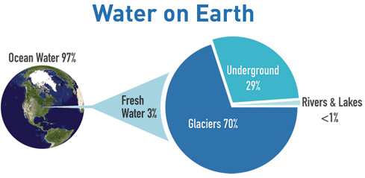
Global Water Outlook
Notes:
Students will now use the measuring cups at their tables.
With your demonstration set of measuring cups, show the class the 1000 ml measuring cup of water. This represents/is a model of all the water on Earth. Have students tell you what a model is.
Where is most of the water on Earth located? (oceans) Of your 1000 mL measuring cup how much would you estimate is fresh water? Think about all of the places freshwater can be found. Have them name as many as they can their list should include rivers, lakes, streams, glaciers, ice caps and groundwater. Come up with 1 guess per group and pour that amount into the next smallest measuring cup (100 mL). Hold up your cup so that we can compare hypotheses. Go around the room and compare which team guessed the most amount of water, and which team guessed the least amount of water.
With your demonstration set, pour 30 ml into the 100 mL cup. This represents the amount of fresh water on Earth (3%). The rest of the large measuring cup is salt water (97%). Have students make the adjustment with their guesses so they too have 30 mL of water in the 100 mL cup. How close were the students’ estimates to the actual percentages?
What is at the Earth’s poles? (ice caps) Nearly 80% of the fresh water is frozen in ice caps and glaciers. Make an estimate of how much non-frozen fresh water there is on Earth from lakes, rivers, and groundwater and pour your water into the smallest (60 mL) measuring cup to match your estimate.
Hold up your measuring cup so that we can compare. Go around the room and compare which team guessed the most amount of water, and which team guessed the least amount of water. With your demonstration set, pour 6 ml into the smallest measuring cup to represent the unfrozen fresh water. Have students make the adjustment with their guesses so they too have 6 mL of water in the 60 mL cup.
So, can we use all the unfrozen fresh water? Nope! Some is too deep underground, some is polluted (ask if they know what polluted means), some is trapped in soils. How much useable water do we have? Guess how many drops of water should go in your “clean water bowl.” Then compare estimates by having student teams announce how many drops they guessed. Go around the room and compare which team guessed the most amount of water, and which team guessed the least amount of water. With your demonstration set, use a pipette to remove a single drop of water (0.0003 ml). Drop this into the bucket. This is the amount of clean fresh water that is not polluted or otherwise unavailable for use.
We need to manage this precious drop very carefully so that there is water for future generations – our kids and grandkids.
*Note: Activity adapted from Project WET “Drop in the Bucket”.
Why is fresh water so important? Who needs water? We can live a month without food, but only a few days without water. Every living thing depends on water to live. Wildlife, fish, plants, and bugs!
We can’t drink salt water without processing it first, called desalinization. There are some coastal communities around the world that are using ocean water as their water source. Desalinization is very expensive and uses a lot of energy to do so. It is better for you and the planet to use fresh water.

Slide 6
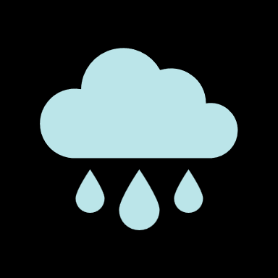
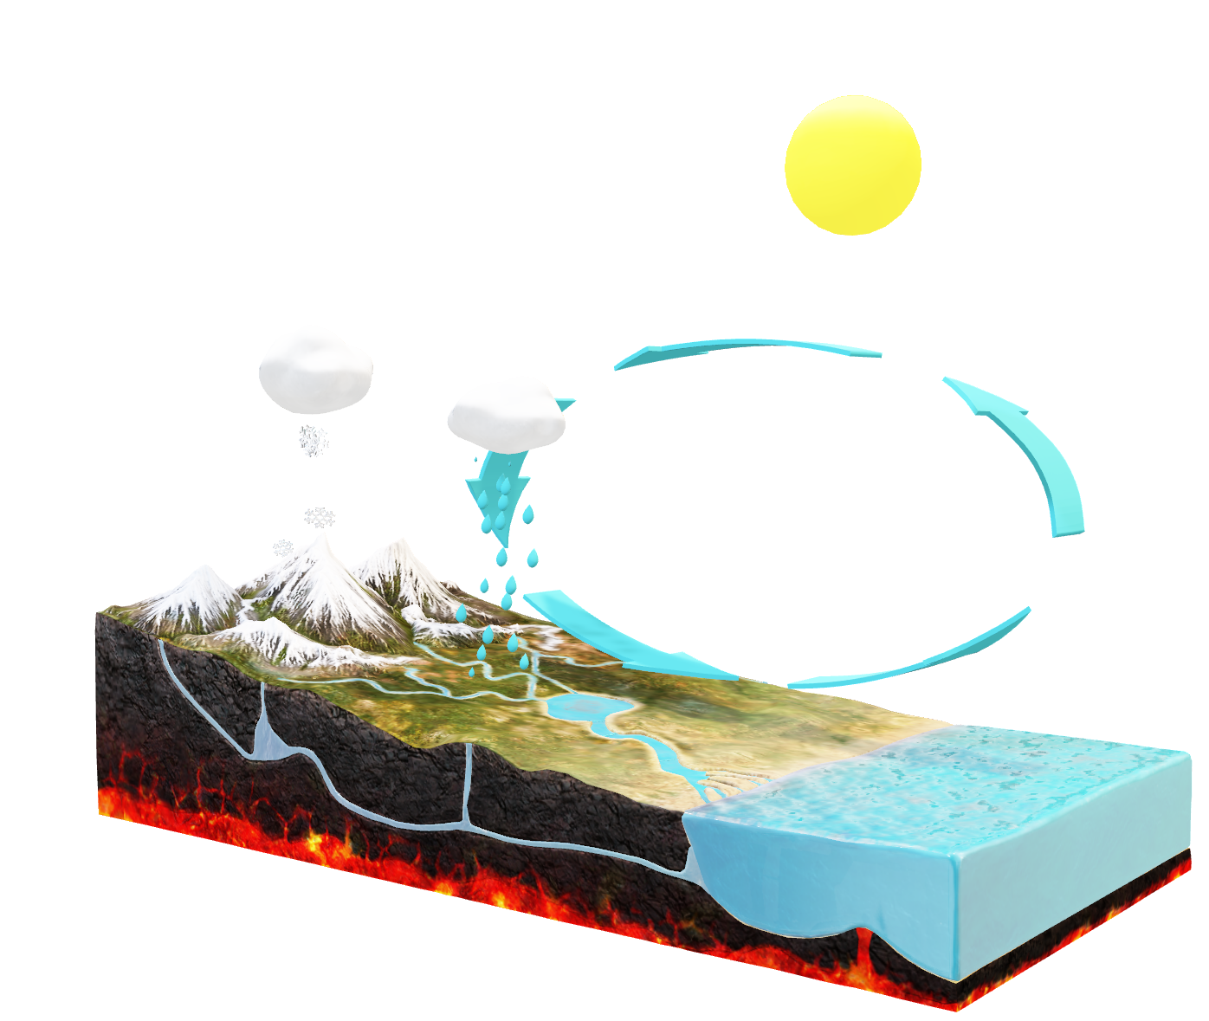
Water Cycle
Notes:
Water is recycled again and again in the Water Cycle. This could be a good time to recap the water cycle or fit in a water cycle lesson. Over time, salt water can become fresh water and vice versa. However, fresh water is not distributed equally around the globe.

Slide 7
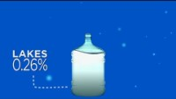
Water Supply
Around the World
Notes:
NASA Show Me the Water Video: https://www.youtube.com/watch?v=4HSFKwho7MQ&t=4s
Let’s watch a 3-minute video about how water is distributed around the world.

Slide 8
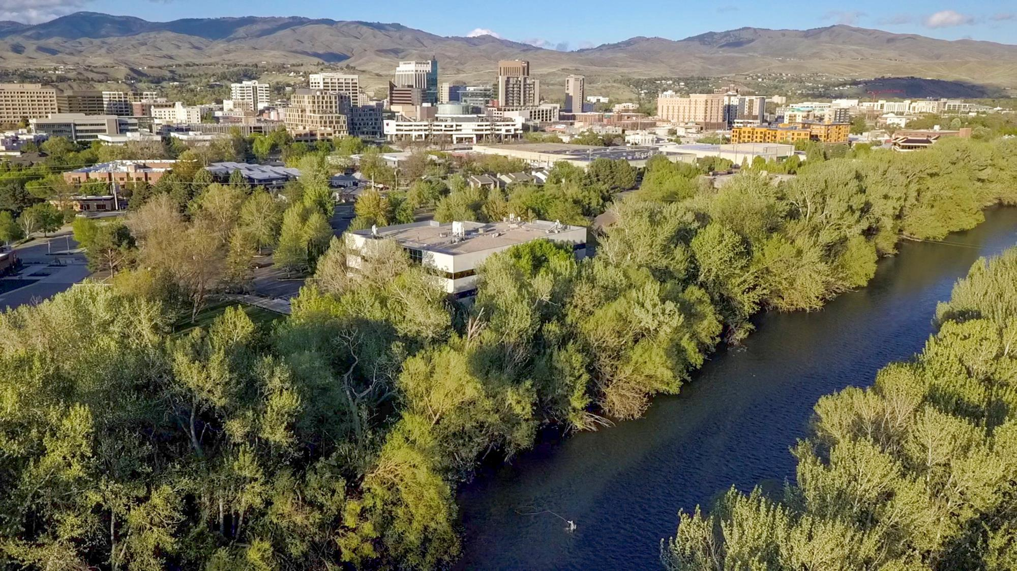
Treasure Valley’s
Water Supply
High Desert
Climate change is impacting our timing of precipitation
Less Snowpack means less water
Idahoans uses more domestic water per person than any other state
Notes:
USGS 2015 Idaho Water Use: 286 gallons per person per day
Mainly because the dry climate leads to more household water use for lawn and garden irrigation.
Public and Domestic Supply includes water for household use, industries, public parks, pools and buildings and maintenance of water systems.
Largest water uses: Irrigation; then Aquaculture, Public Supply & Domestic Water
Water is especially important to us in the Treasure Valley. It helps grow crops and manufacture things. Water is the reason Boise and the surrounding communities were even settled. But we sometimes forget that we live in a desert. Does anyone know how much rain we get on average each year in the Treasure Valley? We only get about 11 inches of rain per year. This rain is not enough to replenish the groundwater supplies that we use. We get our drinking water from the groundwater and the Boise River. In Boise, the ratio is 70% groundwater and 30% Boise River Water. As we use more water in the Treasure Valley, we are going to be depending more on the Boise River for water in the future. In Idaho we use more water per person than most other states, on average every one of us is using 286 gallons per day.

Slide 9
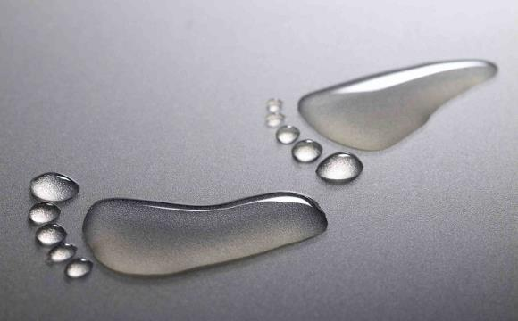
What is a
Water Footprint?
Water Footprint
The total amount of direct plus virtual freshwater we use.
Virtual Water
The water it takes to produce the things we eat, wear and use.
Notes:
For this next activity, I’m going to give each team of students a piece of paper with a footprint outline on it and a marker (or students may trace the shape of their shoe onto a piece of paper). What I want you to do is work as a team at your tables to brainstorm your team’s ‘water footprint.’ Think of activities that you, your family and your friends do each day that use water, and think about it year-round, for example water use in the summer vs. the winter. I’ll give you five minutes to complete this.
Use PowerPoint to reveal what a water footprint truly means: the sum of both your direct and indirect or virtual water that you use daily.

Slide 10
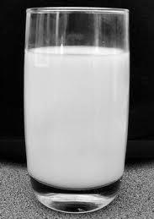
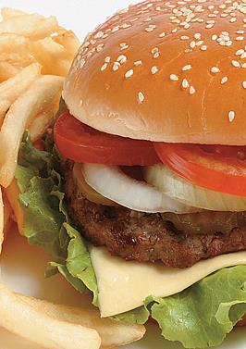
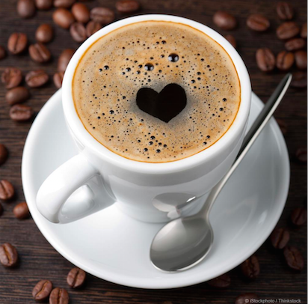
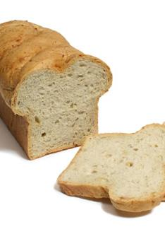
Guess the Water Footprint for…
8 oz. of Milk
60 gallons of WATER!
1 Hamburger
634 gallons of WATER!
8 oz. of Coffee
37 gallons of WATER!
1 Slice of Bread
10.5 gallons of WATER!
Notes:
Here are some examples of the virtual water footprint of some common foods and items. Can you guess how much water it takes to produce these items?
More examples can be found at: https://watercalculator.org/water-footprint-of-food-guide/

Slide 11
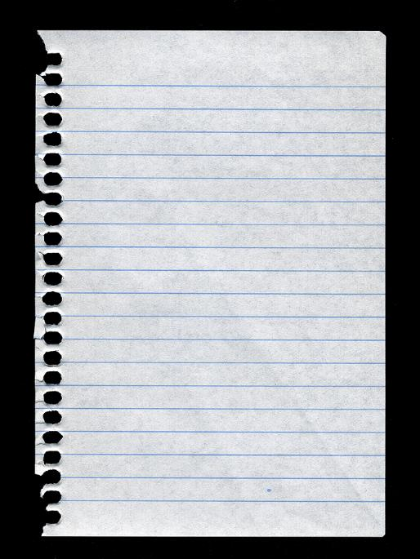
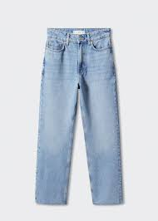
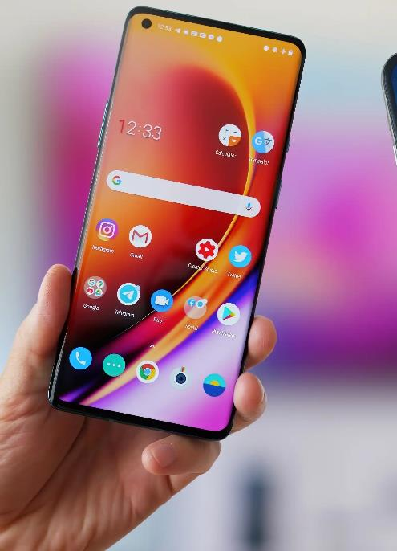
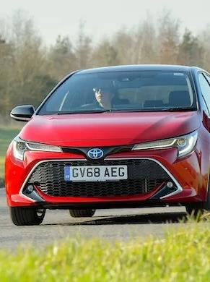
Guess the Water Footprint for…
Car
13,737-21,926 gallons of WATER!
1 piece of Paper
1.3 gallons of WATER!
Jeans
2,866 gallons of WATER!
Smart phone
3,190 gallons of WATER!

Slide 12

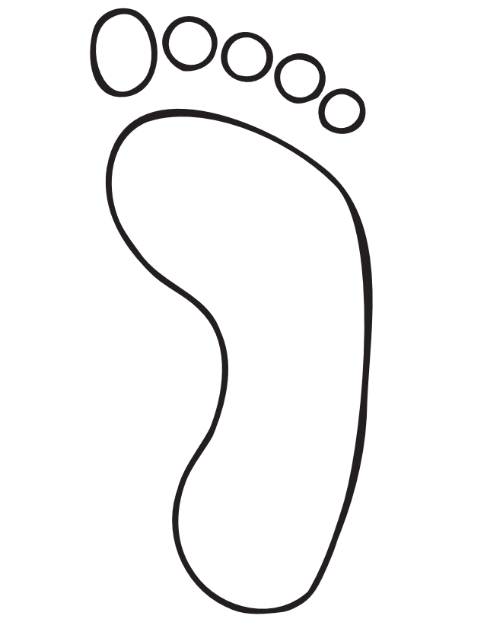
Your
Water Footprint
Agriculture
Parks
Pools
Houses
Waterpark
Gardening
Boating
Swimming
Recreation
Electricity
Industry
Carwashes
Notes:
Show the example of a water footprint. You could edit this to show your own personal water footprint. As a team, brainstorm how you can personally save water. Write your team’s ideas for water conservation on the back of your footprint, or around your footprint.

Slide 13
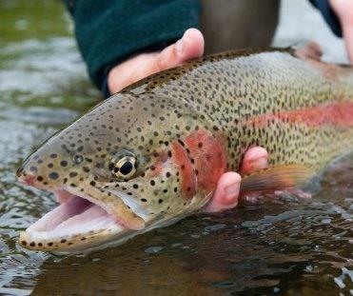
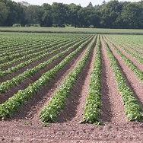
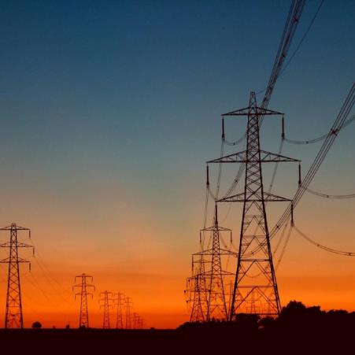
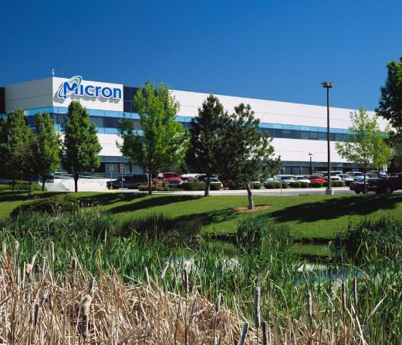
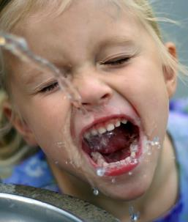
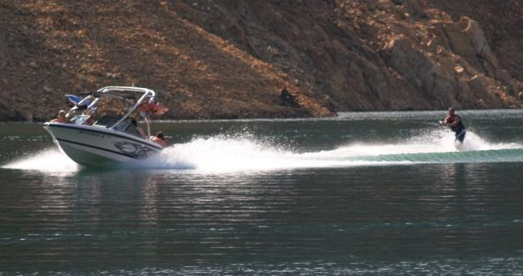
Idaho’s Water Footprint
Idaho uses more domestic water per person than any other state.
Idaho also ranks 3rd for total water use of all states.
97% of our water is used in irrigation and aquaculture.
2% is used by the public
1% is used in other industry
Notes:
How does the Idaho and the Treasure Valley use water? Take ideas and reveal the pictures on the slide. Drinking, fish and wildlife, agriculture, recreation, industry, hydropower

Slide 14

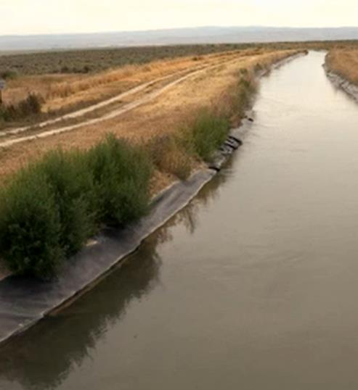
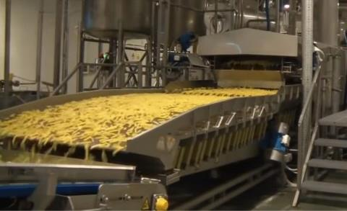
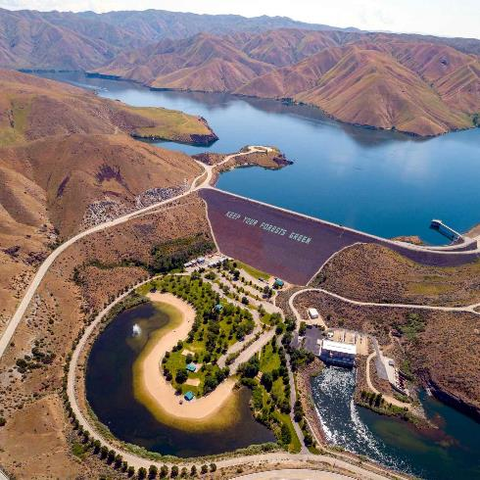
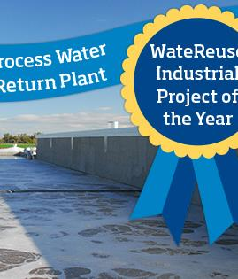
Agriculture
Industry
Water Storage
Industry
Community Solutions
Notes:
There are so many water uses in the Treasure Valley that it is important for groups to work together to implement solutions. Share a few solutions you can choose from ones below.
Agriculture Water Conservation Example: Use efficient irrigation systems, such as center pivots, instead of flood irrigation
Water Storage Example: Boise has 3 major dams upstream that create reservoirs of water for year-round storage
Industry Example: Simplot potato processing plant in Caldwell: Among the innovative aspects of the Idaho Plant is the facility’s zero-liquid discharge system. The plant can reclaim over 1 million gallons of water a day and returns it for reuse in the potato production process. Remaining discharge is used for irrigation of crops or eliminated through spray evaporation technology.

Slide 15
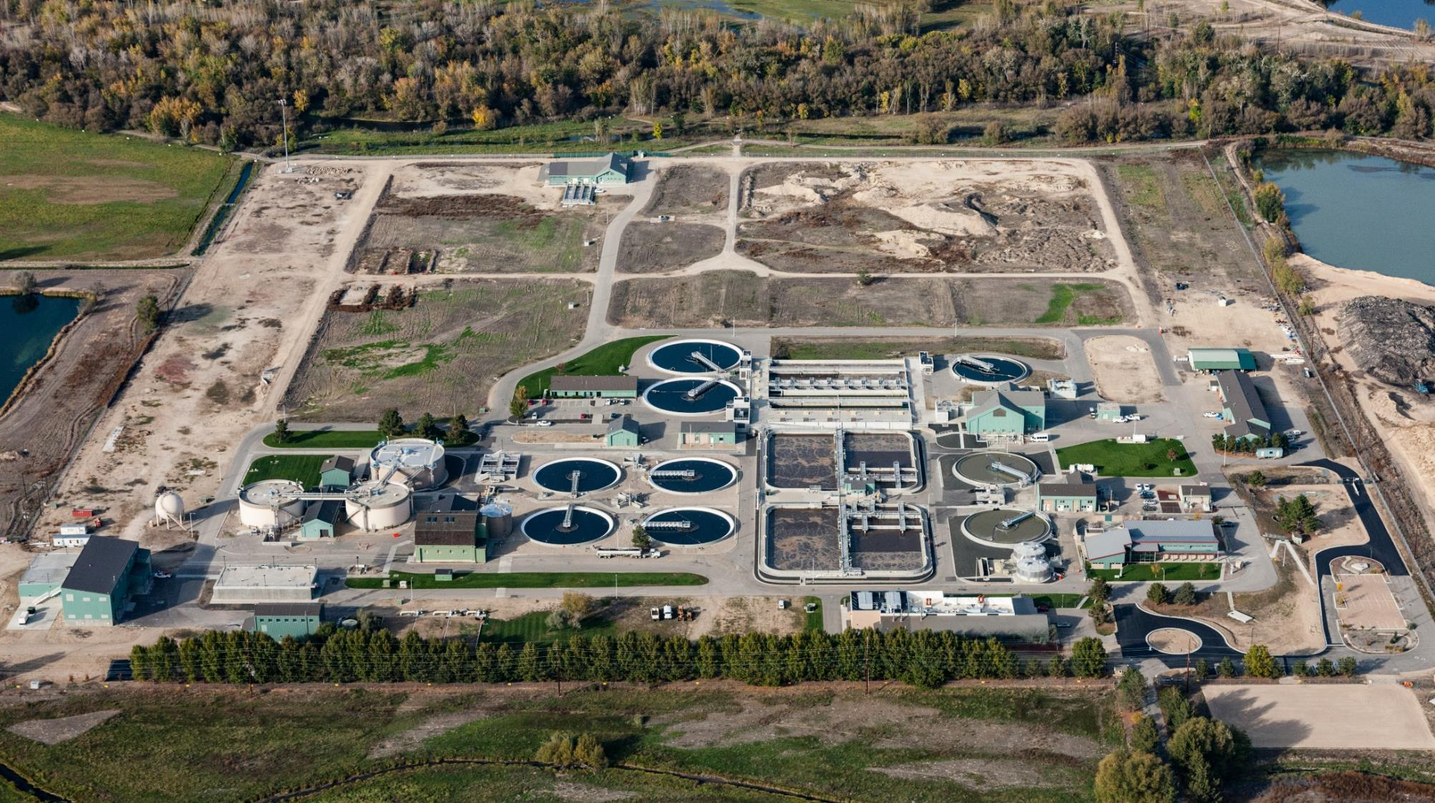
West Boise Water Renewal Facility
Notes:
Another important way that we conserve water and keep our water healthy are Water Renewal facilities. They clean our used water ( any water that we use and send down a drain into the sewer) and put that cleaned water back into the environment.

Slide 16
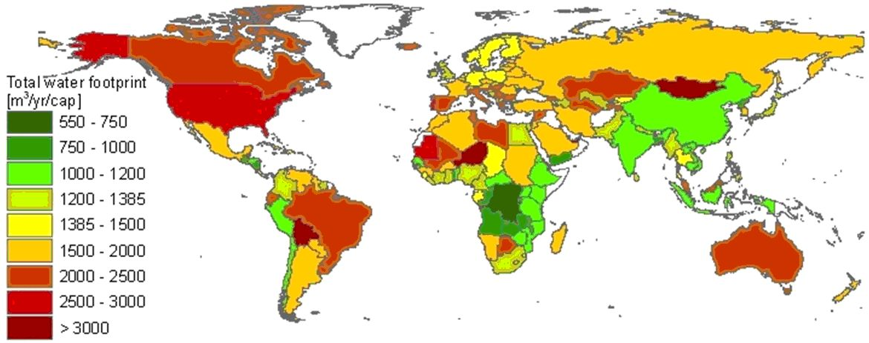
How Much Water Do We Use?
National Consumption 1996 - 2005
= 660,000 – 792,000 (gallons/ year) = 1808 – 2170 gallons per day
http://temp.waterfootprint.org/
How many people depend on water?
Notes:
Lets look at the water footprints of different places. What do we notice?
Water usage varies among different countries. Why do you think that is? As you already might have guessed, in the U.S. we are water hogs - we use more than twice the world average, or 2,500 – 3,000 cubic meters per person. That's equivalent to an Olympic-sized swimming pool for each and every one of us, or 2.5 million liters each. The Chinese, to compare, use 1,000 cubic meters annually. The countries where water poverty is the worst and water usage is the lowest are Mozambique, Rwanda, Haiti, Ethiopia, and Uganda - these five use 15 liters or less daily.
Some reasons = Amount of available water in varying climate zones, discrepancy in economics and technology, industrialization, and most importantly lifestyle.
How many people depend on water? Link to Human Population Clock: http://galen.metapath.org/popclk.html

Slide 17
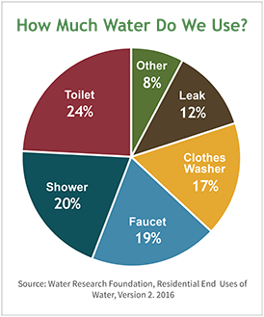
The average American family uses more than 300 gallons of water per day at home.
Roughly 70 percent of this use occurs indoors.
Notes:
Talk through ways that we can use less or use our water more efficiently.

Slide 18
Today We Learned
There is limited freshwater on Earth
We use a lot of water!
You can be part of the solution – Help Save Water!
Notes:
Recap what we learned. There is a limited supply of freshwater on Earth. As humans we use a lot of water. We can be a part of the solution and help to conserve water!

Slide 19
Notes:
If you want to learn more about water in the Treasure Valley you and your family can visit the WaterShed! The center is always free to visit. More info; Boisewatershed.org

