Slide 1


Exploring Changing Wildfire in Idaho
Burning Questions

Slide 2
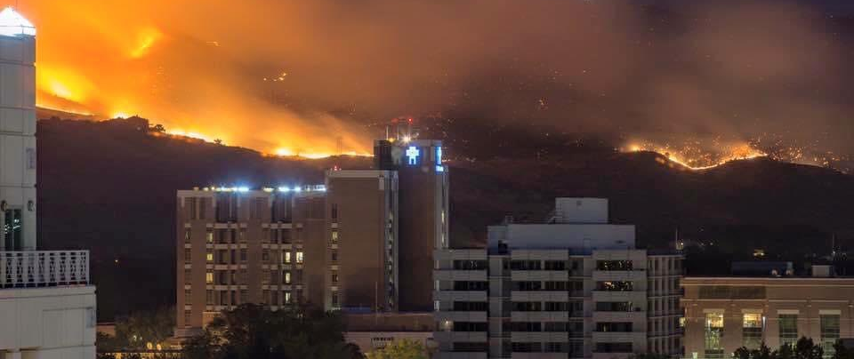
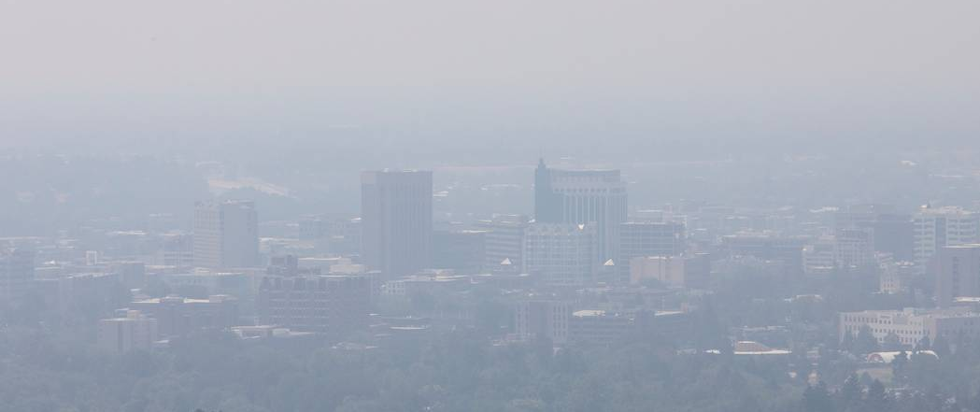
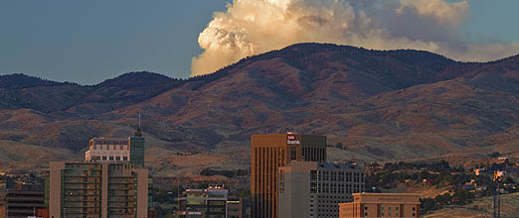
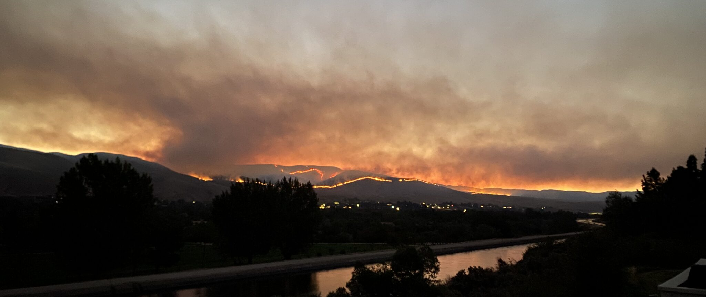
Tablerock Fire, 2016
Thick Wildfire Smoke, 2020
Pioneer Fire, Idaho City, 2017
Valley Fire, East Boise October 2024

Slide 3
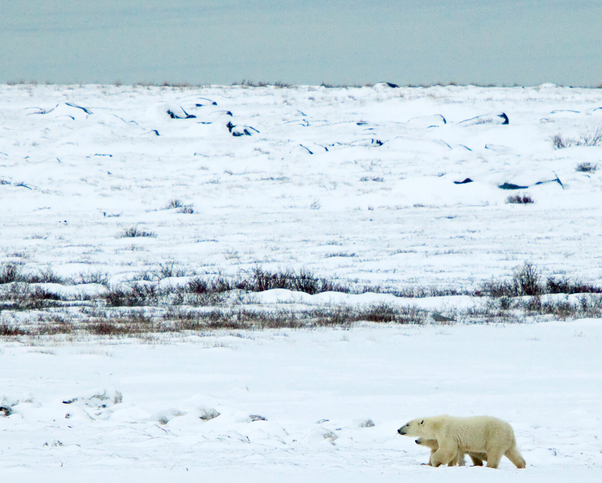
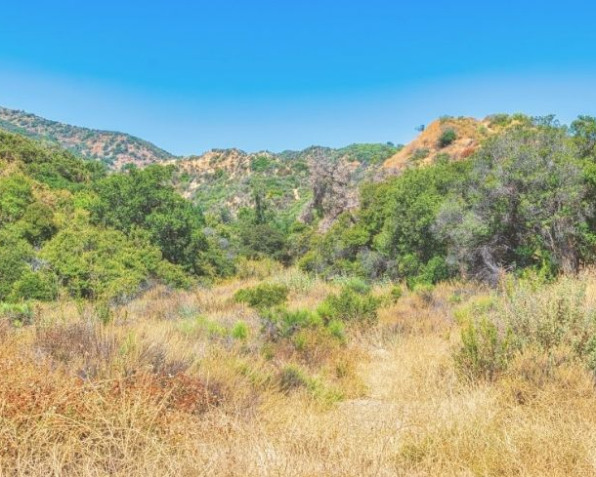
Fire Ecology 101: How Would Wildfire Move Here?

Slide 4



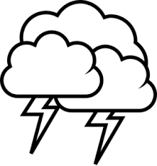

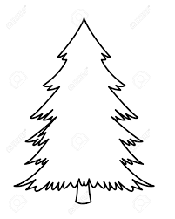

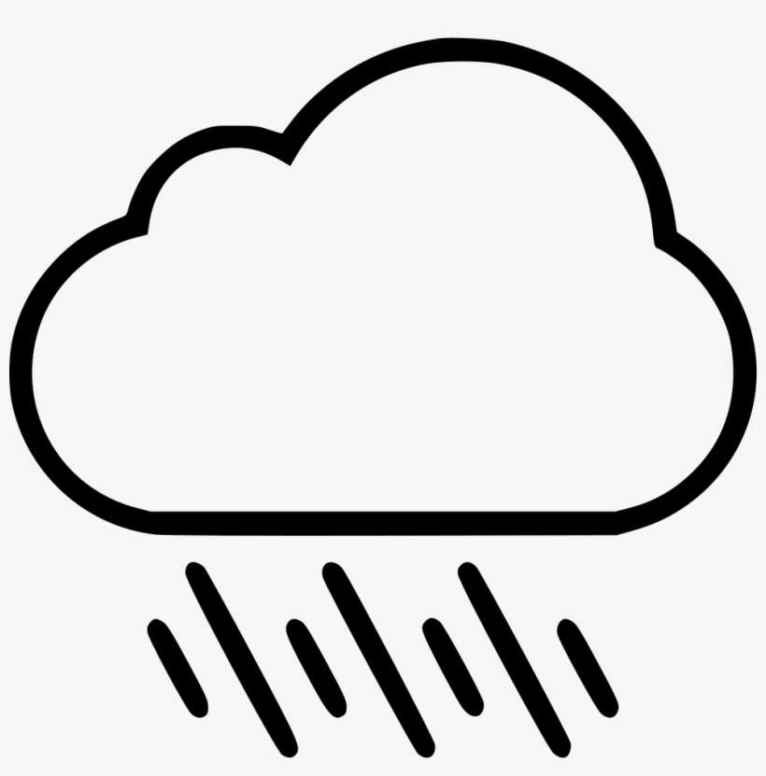
Fire
Regime
Vegetation
Ignitions
Climate

Slide 5
Fire Ecology 101: How Would Wildfire Move Here?

Slide 6
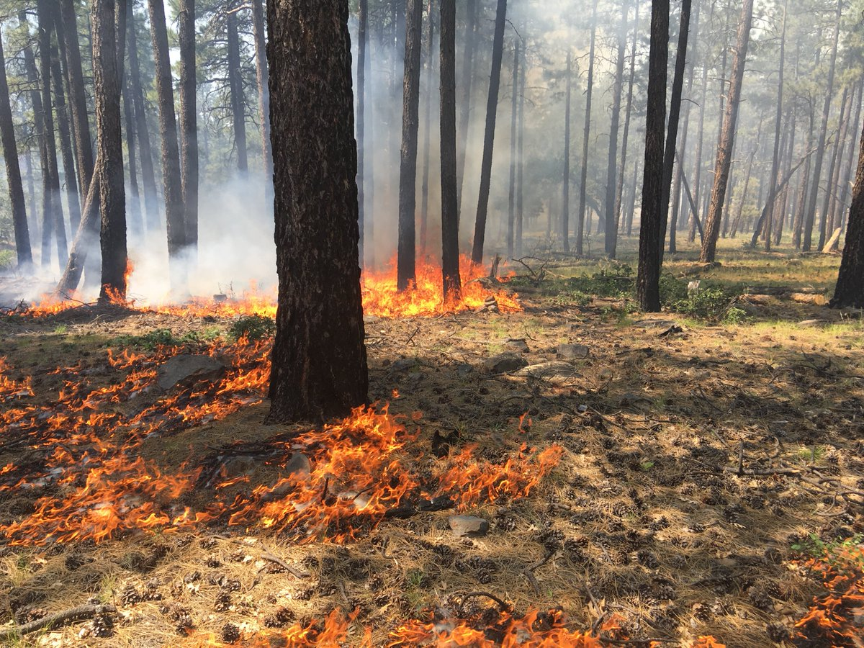
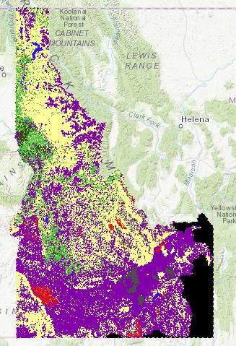
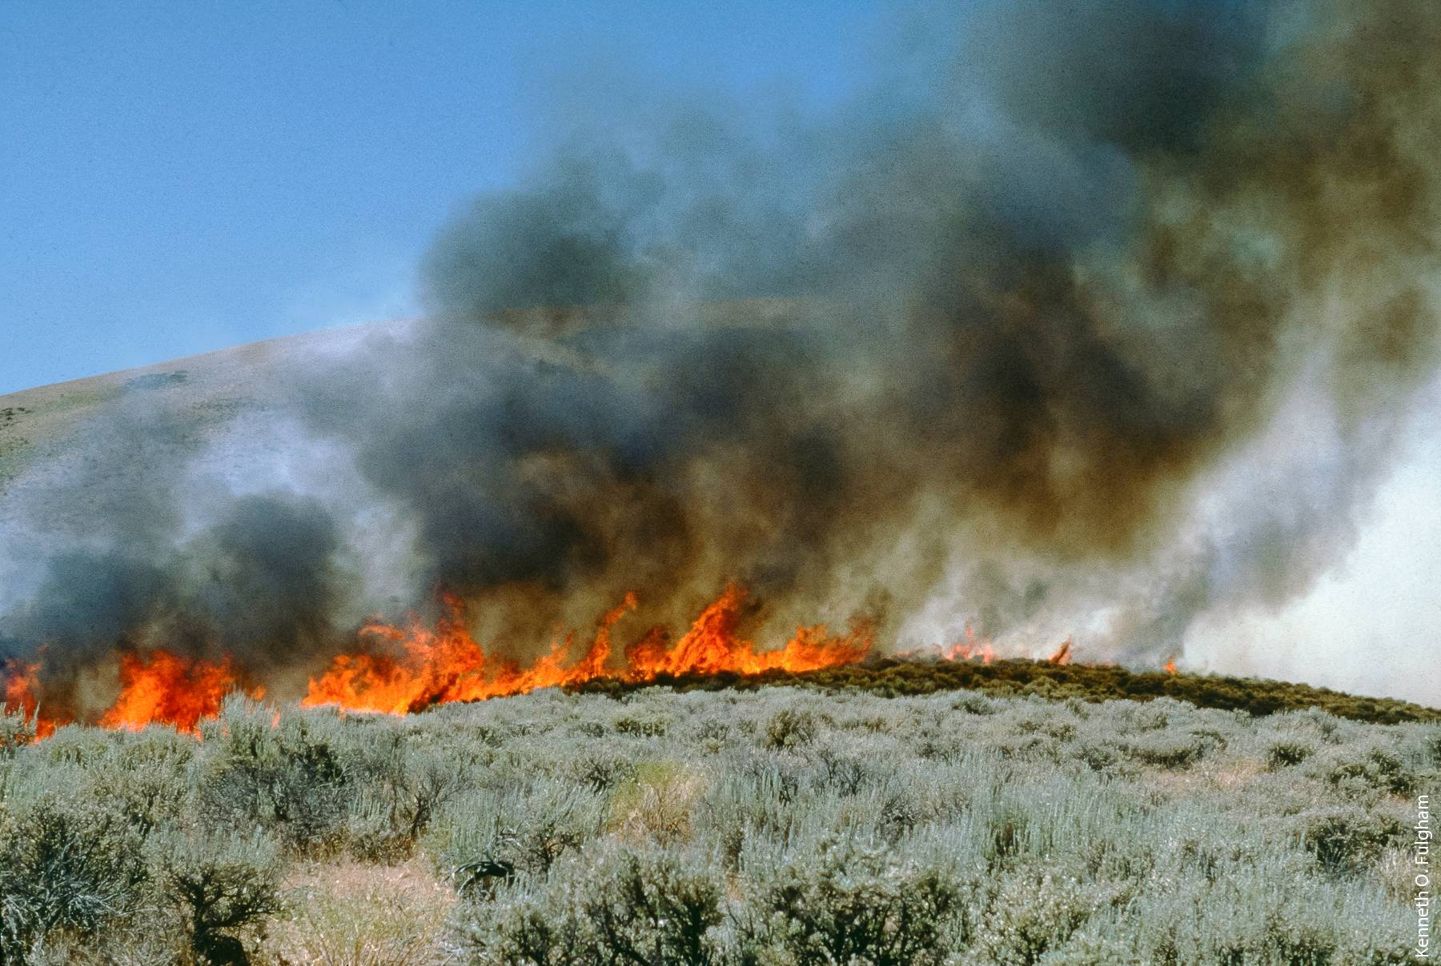
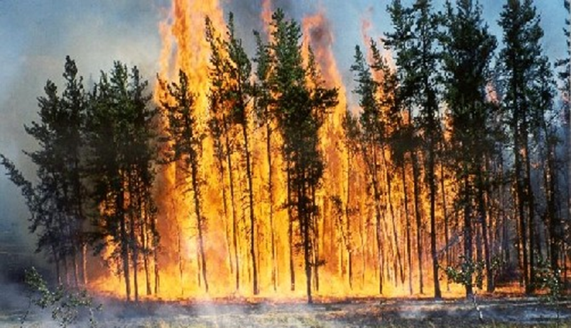
Idaho Fire Regimes

Slide 7
Discuss the questions on the first page. Make observations about your ecosystem in the first section of your poster.

Slide 8
On your poster, answer the question:
How does fire move through your ecosystem?

Slide 9
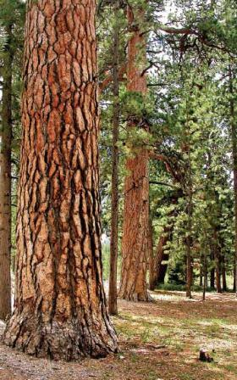
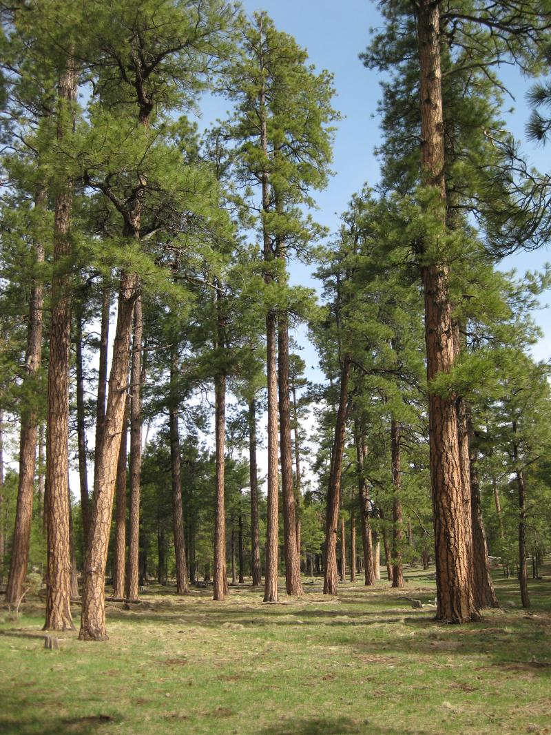
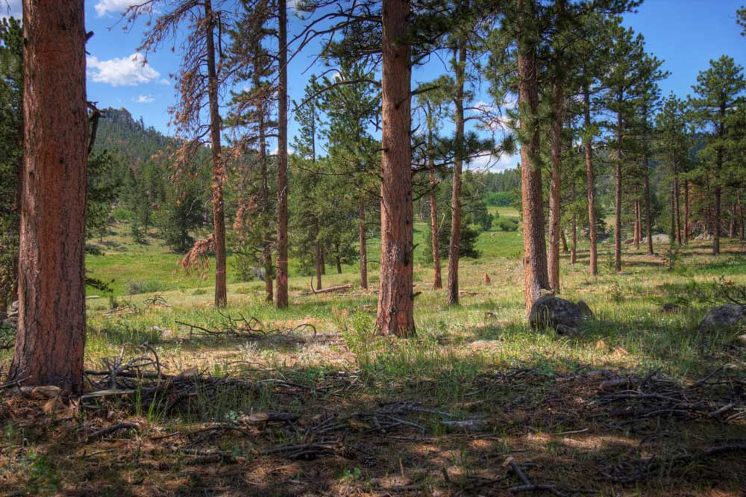
Fire Regime:Ponderosa Pine Forest
How would fire move through your ecosystem?

Slide 10
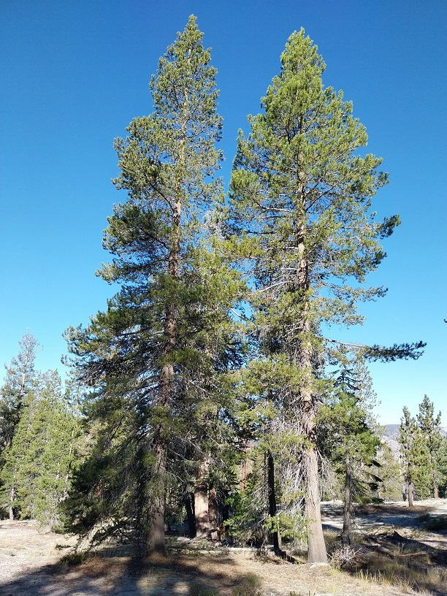
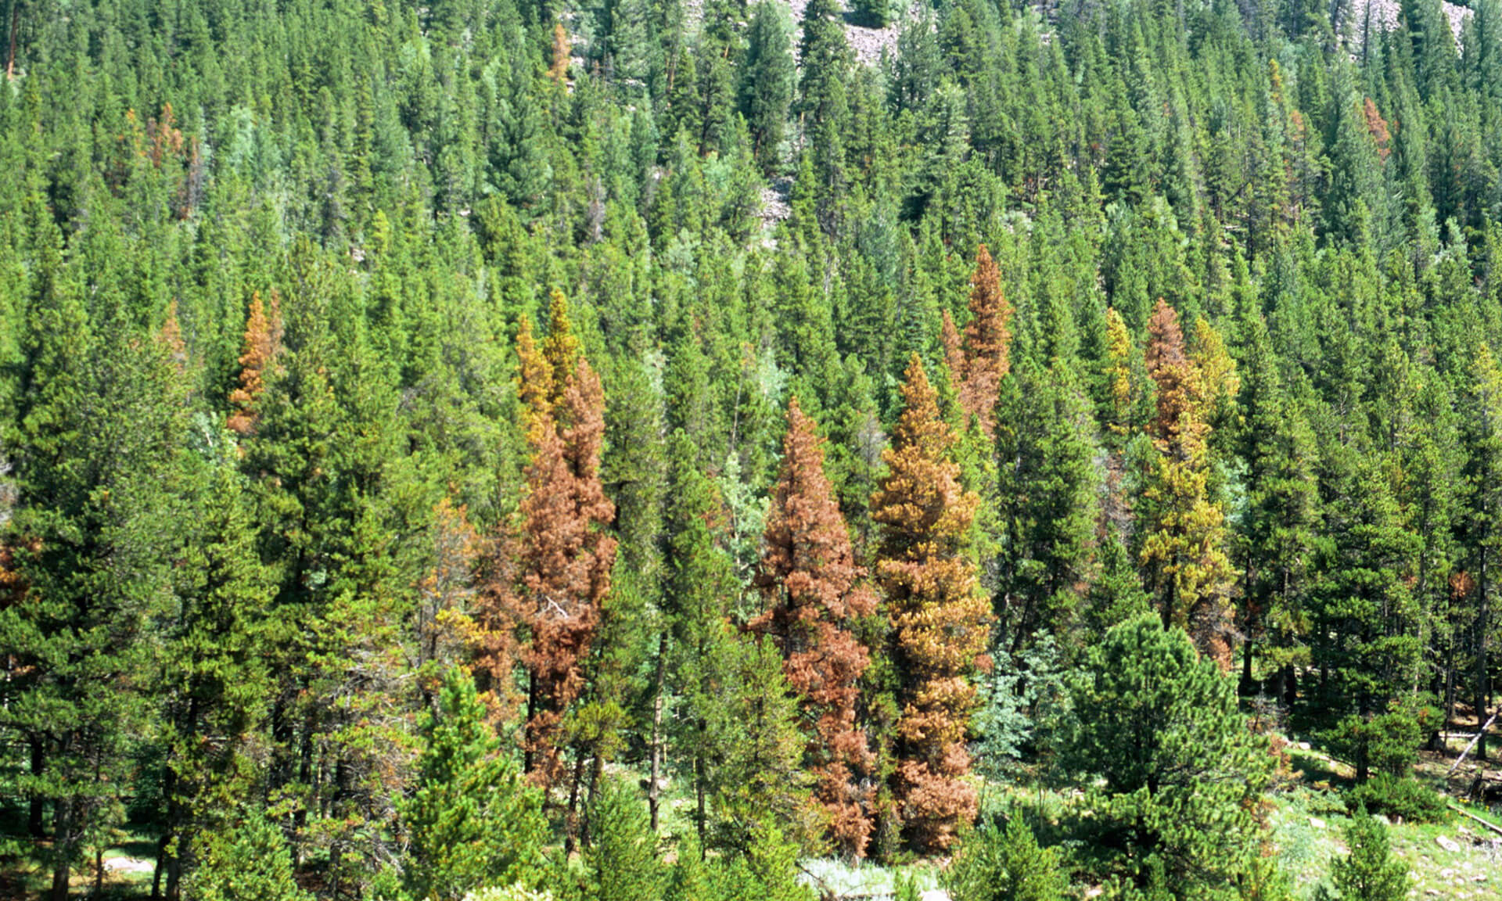
Fire Regime: Lodgepole Pine
How would fire move through your ecosystem?

Slide 11
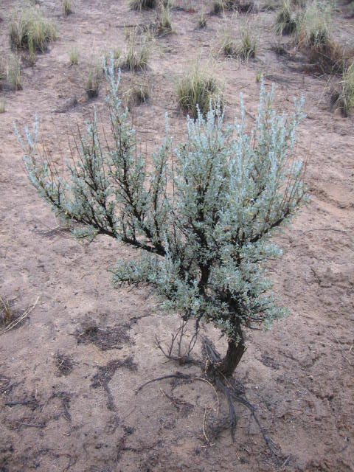
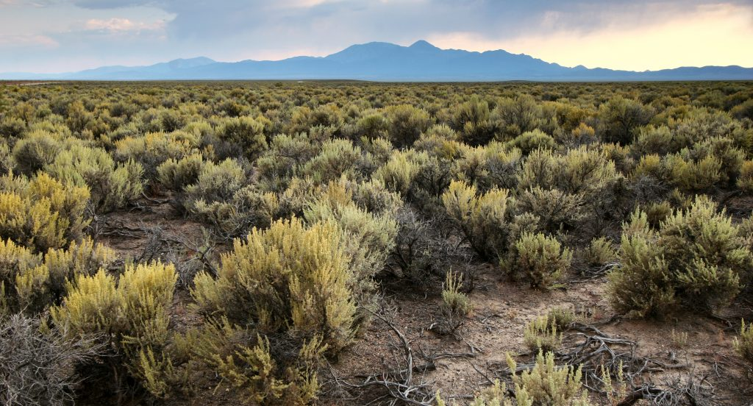
Fire Regime: Sagebrush Steppe
How would fire move through your ecosystem?

Slide 12
“How is fire changing in our ecosystem?”

Slide 13
Work with your group to look through your packet carefully. Talk about what you see and read.
Then, using notes or drawings, show how your ecosystem has changed.

Slide 14
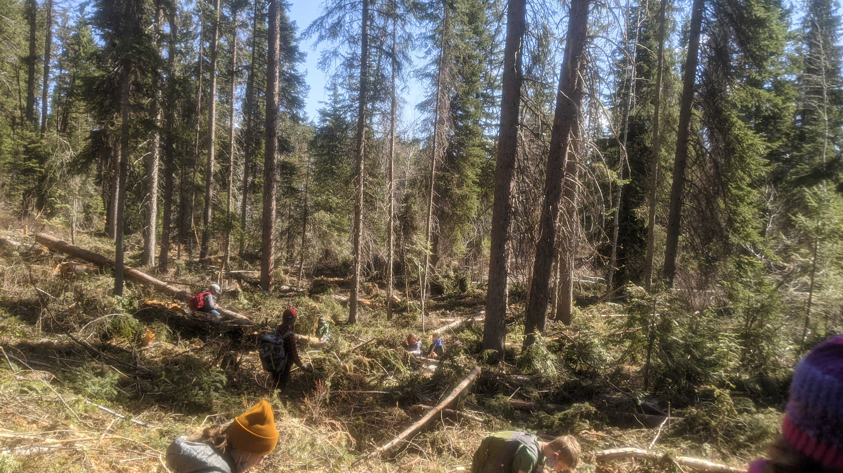
Fire Suppression
Ponderosa State Park in 2020
A typical Ponderosa Pine Forest

Slide 15
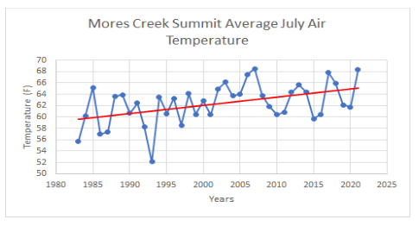
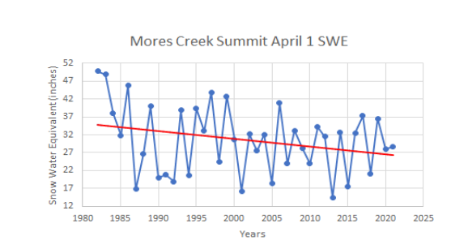
Earlier Snowmelt

Slide 16
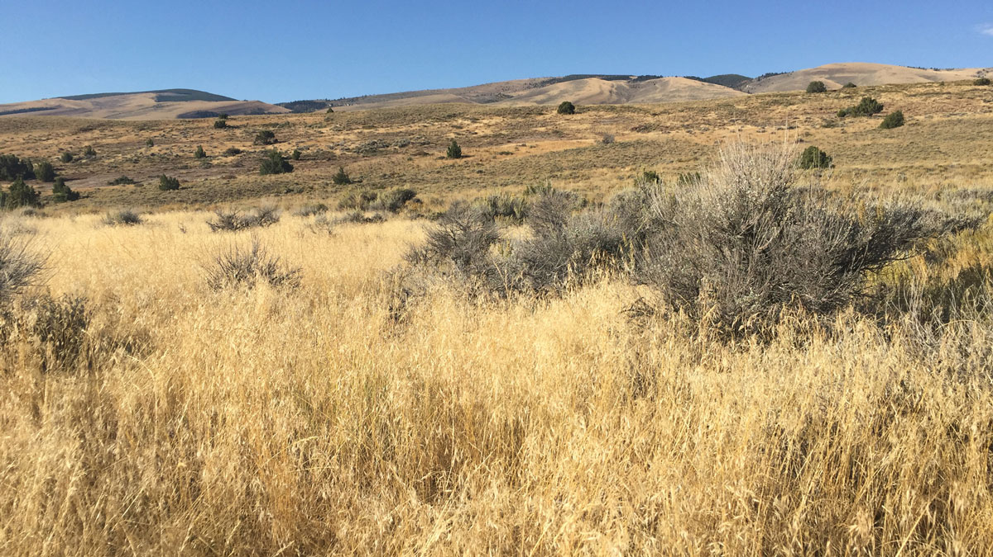
Invasive Species

Slide 17
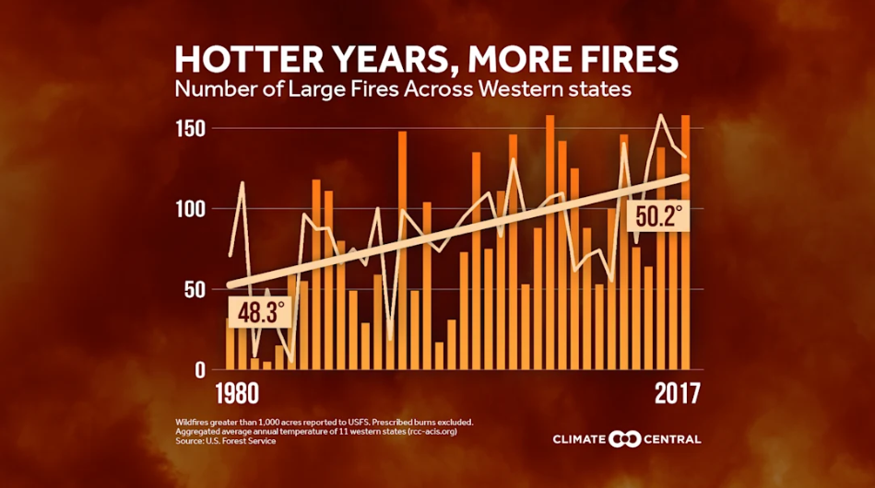
Each ecosystem is being affected in different ways—like fire suppression, invasive species, or changing snow patterns—but they all have one thing in common: warming temperatures from climate change are making fires worse everywhere.

Slide 18
Fire Box instructions
½ of your box should be the historic
½ the changed fire regime
Recreate your drawing and notes with the materials in your fire box. Make this as accurate as possible.

Slide 19
You’re the expert!
Label your last box “Our actions”.
Work together to read through the information in your article.
Then, using that information and your own ideas, think about what actions you would recommend to manage your ecosystem.

Slide 20
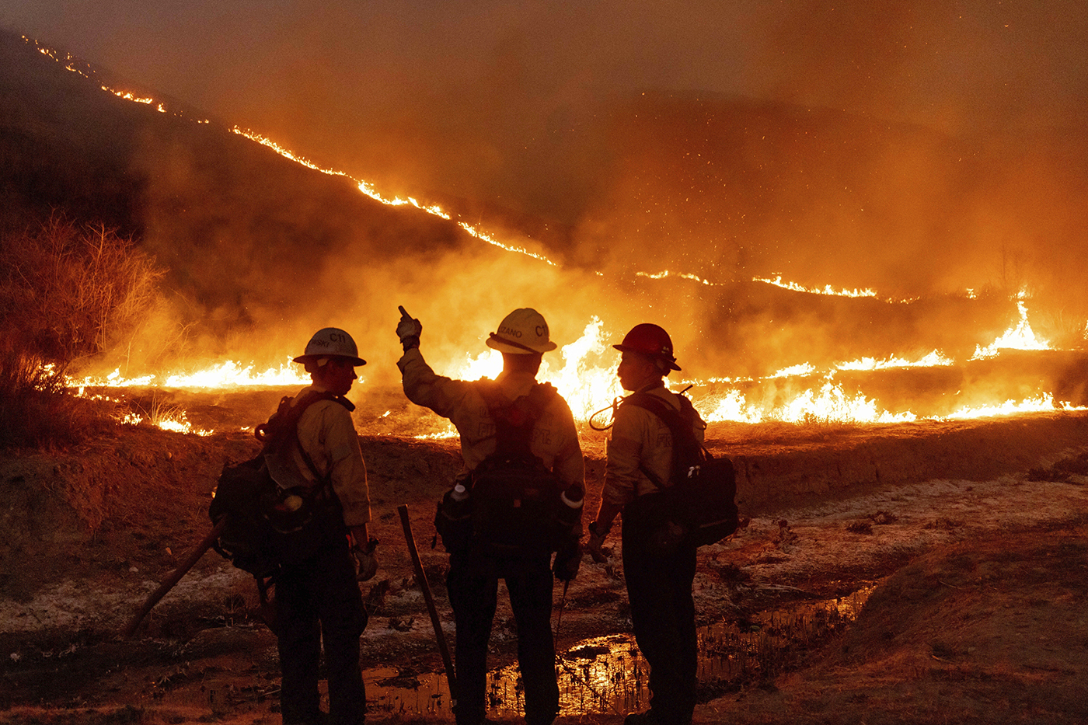
Living with Fire:
Science, Change, and Choices

